Slide 1
Part 3: Knowledge Modeling – Information Extraction

Slide 2
Populating Knowledge Bases
Manual creation of knowledge bases is expensive
Can we produce such knowledge automatically?
Idea: Extract knowledge from documents
Challenge: Knowledge is encoded in natural language
Objectives
Automated or accelerated creation of knowledge bases
Support for structured search on documents
Notes:
Traditionally knowledge bases are created manually, either by experts (e.g., WordNet) or by crowd-sourcing (e.g., WikiData). This is expensive. In the case of WordNet, it took tens of years to construct the knowledge base, in the case of WikiData (resp. WikiPedia) we all know about the notorious difficulty to finance this endeavor. So an interesting problem is whether such knowledge bases could not be automatically constructed.
For automatic construction we can exploit all information that is digitally available, e.g., all documents accessible on the Web. These documents encode massive human knowledge in natural language. So the problem is to extract such knowledge by analyzing natural language text, which is not an easy problem.
The results would, however, be immensely useful. First, we could create massive knowledge bases in a nearly automated way, and furthermore these knowledge bases could be used to annotate documents, in particular the documents from which the knowledge has been extracted, for supporting more expressive and precise searches and analysis.

Slide 3
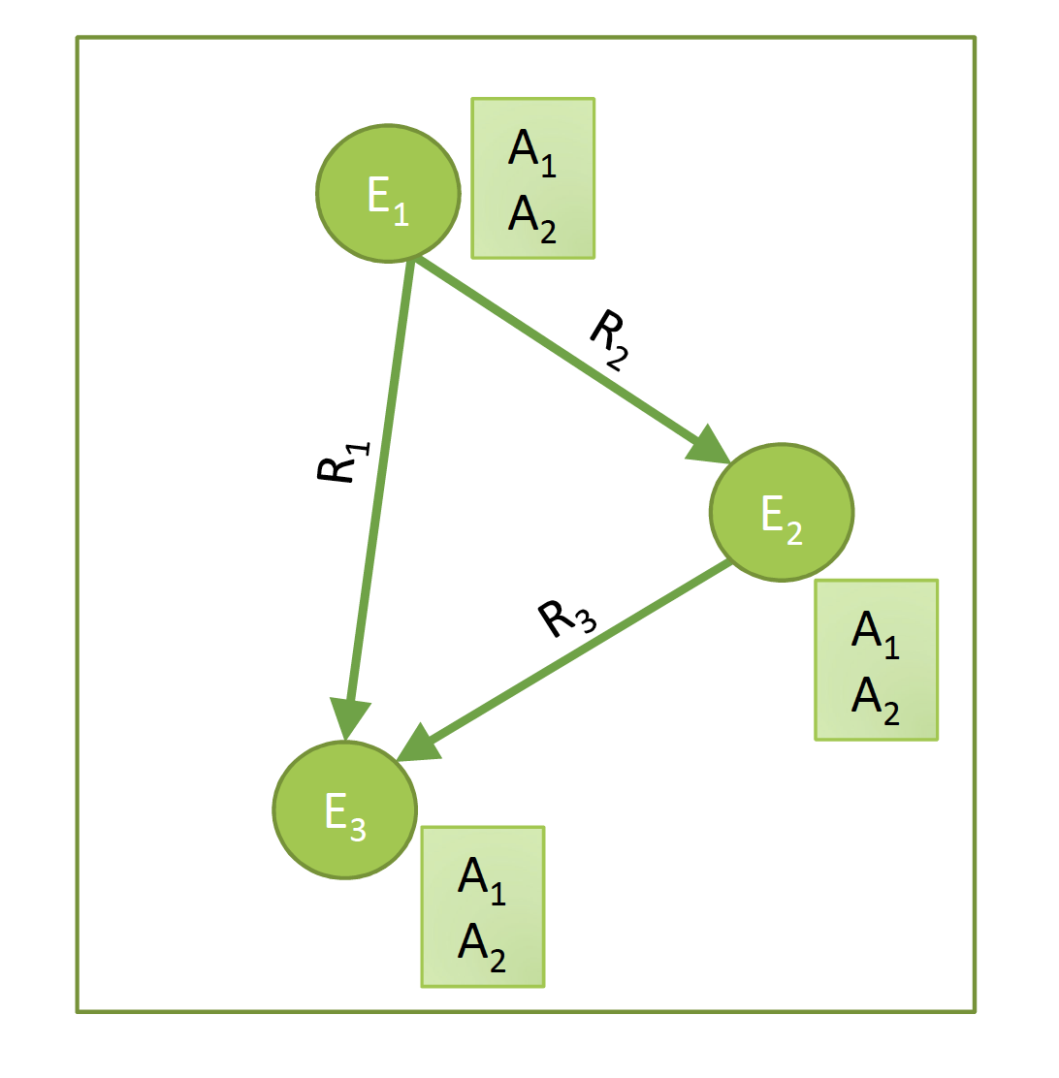
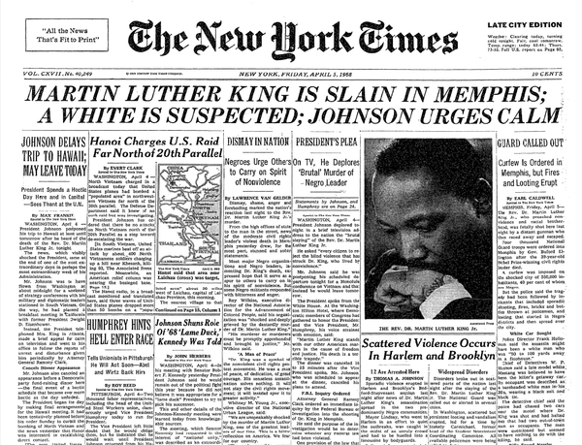
Knowledge Extraction
From text to knowledge
Who are the entities?
What are their attributes?
How are they related?
Notes:
For extracting knowledge from textual content, we can consider the different constituents of a knowledge graph separately: entities, attributes and relationships.

Slide 4
Basic Questions in Knowledge Extraction
Who are the entities?
Keyphrase extraction
Named entity recognition
What are their attributes?
Named entity recognition
How are they related?
Relation (information) extraction
Taxonomy Induction
Notes:
For each of the three questions of generating the basic entities for a knowledge graph there exist specific problems that have been investigated.
Keyphrase extraction concerns the extraction of typical phrases in a document that could identify basic concepts.
Named entity extraction concerns the extaction and typing of text that represents names of real-world entities.
Information extraction concerns the automated extraction of relationships from text.
Taxonomy induction concerns the automated extraction of a specific relationship, namely generalization, from text.

Slide 5
Knowledge Inference
From available knowledge to more complete and precise knowledge
Notes:
Once knowledge graphs have been extracted from text they can be further processed. This enables the inference of new knowledge from the existing knowledge, but as well the correction, completion and integration of existing knowledge bases.

Slide 6
Basic Questions in Knowledge Inference
Who are the entities?
Entity Linking / Disambiguation
Schema integration
What are their attributes?
Collective Classification
How are they related?
Link prediction
Notes:
Knowledge inference concerns a wide number of problems that have been studied in many different contexts. Some of the basic examples are:
Entity linking and disambiguation, which concerns the problem of identifying which entity names represent the same real-world entity, respective which entity is referred to in case of ambiguous entity names.
Schema integration, which concerns the problem which classes, attributes and relationships in one knowledge bases correspond to which in another one.
Collective classification, which concerns the problem of learning unknown attribute values from the available knowledge in a knowledge base.
Link prediction, which concerns the problem of learning unknown relationships from the available knowledge in a knowledge base.

Slide 7
2. Knowledge Extraction
Keyphrase extraction
Named entity recognition
Information extraction
Taxonomy Induction

Slide 8
3. Knowledge Inference
Entity Disambiguation
Label Propagation
Link Prediction
Data Integration

Slide 9
1. Keyphrase Extraction

Slide 10
Key Phrase Extraction
Idea: key phrase extraction is “the automatic selection of important and topical phrases from the body of a document” (Turney, 2000)
Document summarization, search and indexing
Document classification and opinion mining
EPFL is one of the two Swiss Federal Institutes of Technology. With the status of a national school since 1969, the young engineering school has grown in many dimensions, to the extent of becoming one of the most famous European institutions of science and technology. Like its sister institution in Zurich, ETHZ, it has three core missions: training, research and technology transfer. Associated with several specialised research institutes, the two Ecoles Polytechniques (Institutes of Technology) form the EPF domain , which is directly dependent on the Federal Department of Economic Affairs, Education and Research (EAER).
Notes:
A first type of information extraction method is key phrase extraction. Key phrase extraction aims at identifying words and phrases (phrase = sequence of words) that are particularly typical for the document and characterize important concepts that occur in the document. Key phrase extraction has been developed to support document summarization, where the key phrase gives an overview of the key concepts of a document, and document search and indexing, where a distinctive vocabulary is being used in document searches. Moreover, key phrases can also provide useful features for document classification, i.e. they key phrase extraction can be considered as a feature selection method, and they support opinion mining, identifying distinctive expressions related to opinions. In the example text we see the possible outcome of key phrase extraction, with all key phrases identifies marked in bold.

Slide 11
Keyphrase Extraction Methods
Approach: generate candidate phrases and rank them
Candidate phrases
Remove stopwords
Use word n-grams
Consider part-of-speech tags (POS)
Baseline ranking approach
rank candidate phrases of the document according to their tf-idf value
Advanced approaches
Use of many structural, syntactic features of the documents
Use of external resources, such as Wikipedia, Wordnet
Use of transformer models
Notes:
The basic approach to key phrase extraction is based on principles well known from information retrieval. A first decision is what should be possible key phrases. As in IR stopwords are excluded and key phrase candidates could be all n-grams from the remaining text (where n is typically in the range of 2 to 5). Furthermore part-of-speech tags could be used to further select the candidates, e.g., for excluding all verb phrases.
In order to assess whether a candidate phrase is characteristic for a document, basic tf-idf ranking is a possible approach. As in IR a candidate phrase is considered as relevant for the document if it is at the same time frequent and distinctive. Apart from that, many heuristics have been developed to refine this approach, taking into account additional features of the document. For example, a phrase in the title or a header could be considered as more relevant. Or, external knowledge bases could be used to check whether a phrase corresponds to a commonly known concept. Recenlty, also transformer models have been applied for the task of keyphrase extraction.

Slide 12
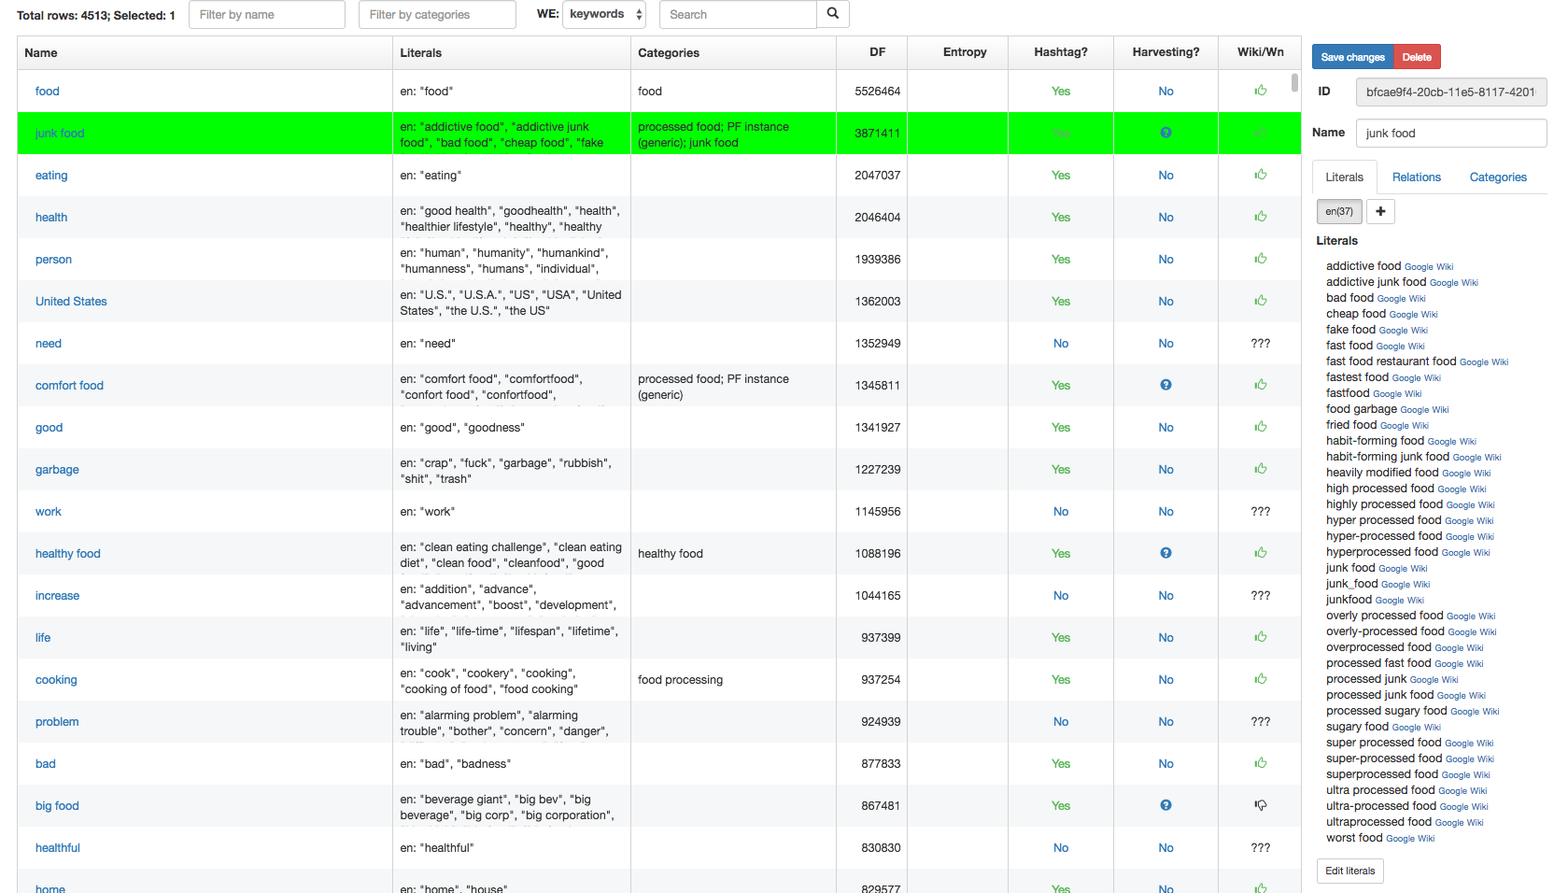
Use of Keyphrase Extraction
Creation of domain-specific thesaurus and taxonomy
Notes:
Key phrase extraction can be used as an initial step to create a domain-specific thesaurus or taxonomy. In the example, we see a thesaurus that has been constructed for the food domain, based on a key phrase extraction. For the phrase “junk food” a large number of synonyms and near-synonyms have been identified. In practice a human expert would not be able to extract reliably all different types of mentions of such a concept.
As a result, this allows, among others, to retrieve documents that refer to this concept with higher recall, than would be possible with a simple keyword search just using the phrases “junk food”, and possibly some alternative phrases found in an ad-hoc way.

Slide 13
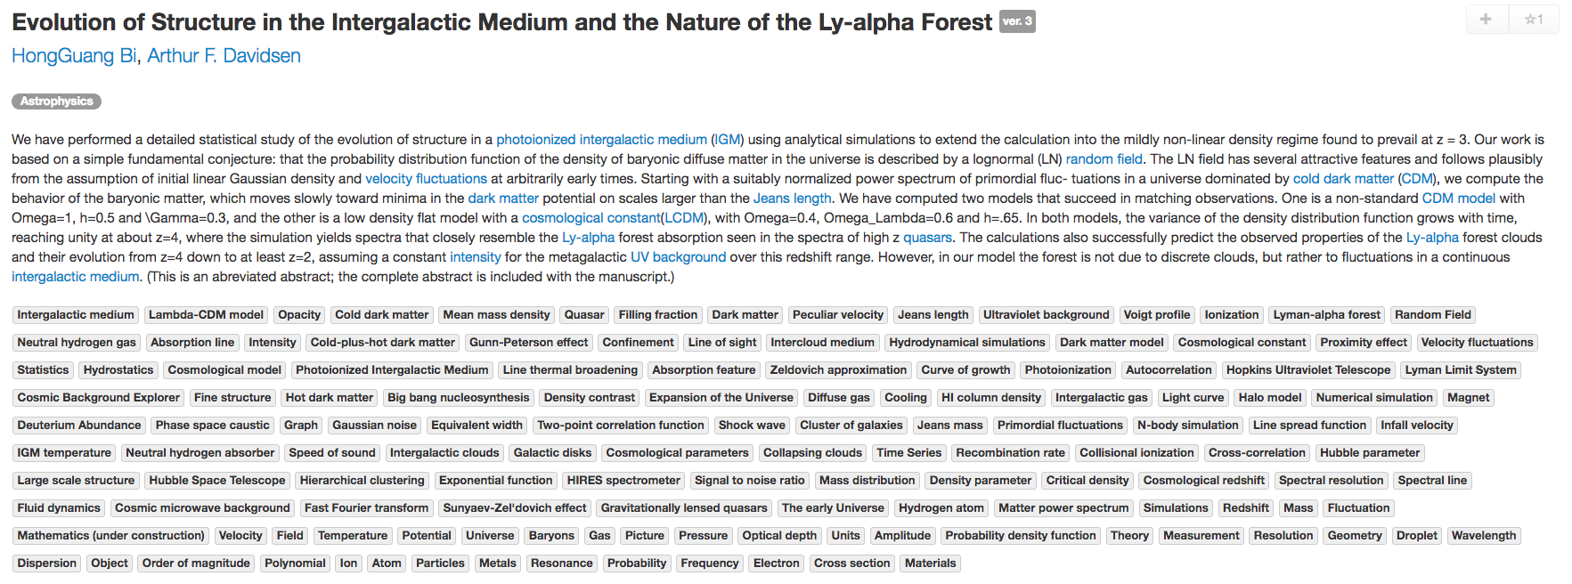
Use of Keyphrase Extraction
Document classification and search
sciencewise.info
Notes:
This is an example of the result of key phrase extraction for scientific documents in physics. A large number of highly specific concepts are identified automatically and allow a scientist to more precisely filter and search the documents. You can try this out on your own at sciencewise.info.

Slide 14
2. NAMED ENTITY RECOGNITION

Slide 15
Named Entity Recognition (NER)
Task: Find and classify names of people, organizations, places, brands etc. that are mentioned in documents
EPFL is one of the two Swiss Federal Institutes of Technology. With the status of a national school since 1969, the young engineering school has grown in many dimensions, to the extent of becoming one of the most famous European institutions of science and technology. Like its sister institution in Zurich, ETHZ, it has three core missions: training, research and technology transfer. Associated with several specialised research institutes, the two Ecoles Polytechniques (Institutes of Technology) form the EPF domain , which is directly dependent on the Federal Department of Economic Affairs, Education and Research (EAER).
EPFL is located in Lausanne in Switzerland, on the shores of the largest lake in Europe, Lake Geneva and at the foot of the Alps and Mont-Blanc. Its main campus brings together over 11,000 persons, students, researchers and staff in the same magical place.
organization
organization
georegion
city
Notes:
Named entity recognition is a more specific task than key phrase extraction. In NER the objective is to identify phrases that are names of specific types of entities, such as people, organizations or places. This, again, is very useful for document classification and search, but also a stepping stone to extract more complex pieces of knowledge, in particular statements, as we will see later.

Slide 16
Named Entity Recognition (NER)
Uses of NER
Named entities can be indexed, linked, etc.
Sentiment can be attributed to companies or products
Information extraction can use named entities as anchors
Commercial tools available
Reuters’ OpenCalais, AlchemyAPI (now IBM)
Python libraries: NLTK NER, Spacy
Notes:
NER has in particular many commercial applications, e.g., for marketing or studying public perception, by linking volume of communication, sentiment and popularity to specific entities, such as products, companies or organizations. Thus, there exist a number of commercial tools that offer this type of service.

Slide 17
NER as Sequence Labelling Task
Sequence of tags, indicating whether a word is inside (I) or outside of an entity (O)
The occurrences of entities (can be) typed
EPFL is located in Lausanne in Switzerland , next to Lake Geneva
I O O O I O I O O O I I
ORG GEO GEO GEO GEO
A classification problem!
Notes:
The basic task of NER is to detect whether a word belongs to an entity name or not. Furthermore, when an entity name is detected it can be classified according to the type of the entity, e.g. an organisation (ORG), a location (GEO), a person etc.
When analyzing a text entity, NER is thus a classification problem, where for each word it needs to be decided whether it is inside or outside of an entity name. More detailed classifications, in particular whether a word is the beginning or end of entity name, could also be done. Note that in this context also punctuation marks are considered as words, as they may carry important information on the presence of an entity.

Slide 18
NER as Classification Task
EPFL is located in Lausanne in Switzerland , next to Lake Geneva
I O O O I O I
Next predicted label
Features:
Neighboring words
Preceding labels
Classifier
Naïve Bayes, HMM, CRF, …
Notes:
Given that NER can be understood as a classification problem, we have to answer two questions, namely which are the input features for the classifier and which is the classification algorithm to be used. As for the input features, typically the neighborhood of a word is considered. In this neighborhood we find other words, which can be used as directly as features and from which a number of derived features can be produced. One additional type of feature that is specifically used in NER is the labels that have been produced by the classifier for the words preceding the word to be classified. Thus, the classifier classifies words while reading the words in the sequence they appear in the document. Thus, even though in principle any classifier could be applied, e.g. Naïve Bayes, which is used frequently in practice, specific sequence-oriented classifiers (HMM, CRF) can have better performance.

Slide 19
Features used in NER
EPFL is located in Lausanne in Switzerland , next to Lake Geneva
Features of “Lausanne”:
Word and neighboring words: Lausanne, in
Part-of-speech tags (POS): POS(Lausanne) = NN
Prefixes and Suffixes: prefix(Lausanne, 3) = Lau
Word shape: WS(Lausanne) = Xxxxxxxx
Short wordshape: SWS(Lausanne) = Xx
Notes:
Here we see a list of typical features that are used in named entity recognition. Some of them are quite specific to the task. For example, part-of-speech tags can be helpful as they allows to distinguish noun phrases (NN) which are typical for entities. Pre- and suffixes are another interesting feature. For example, words ending in “land” would often be locations, thus learning this could help to generalize the classification to new terms that would contain such a suffix. For entities (in particular in English) also the word shape is a important features, as usually names start in capital letters, or acronyms consist of capital letters only.

Slide 20
Exploiting Context
When deciding the entity type exclusively on local context, important information may be missed
The release of Harry Potter and the Philosopher's Stone in 2001 was Watson's debut screen performance.
Although the system is primarily an IBM effort, Watson's development involved faculty and graduate students
Idea: consider a model that takes into the account the sequential structure of language and exploits sentence context

Slide 21
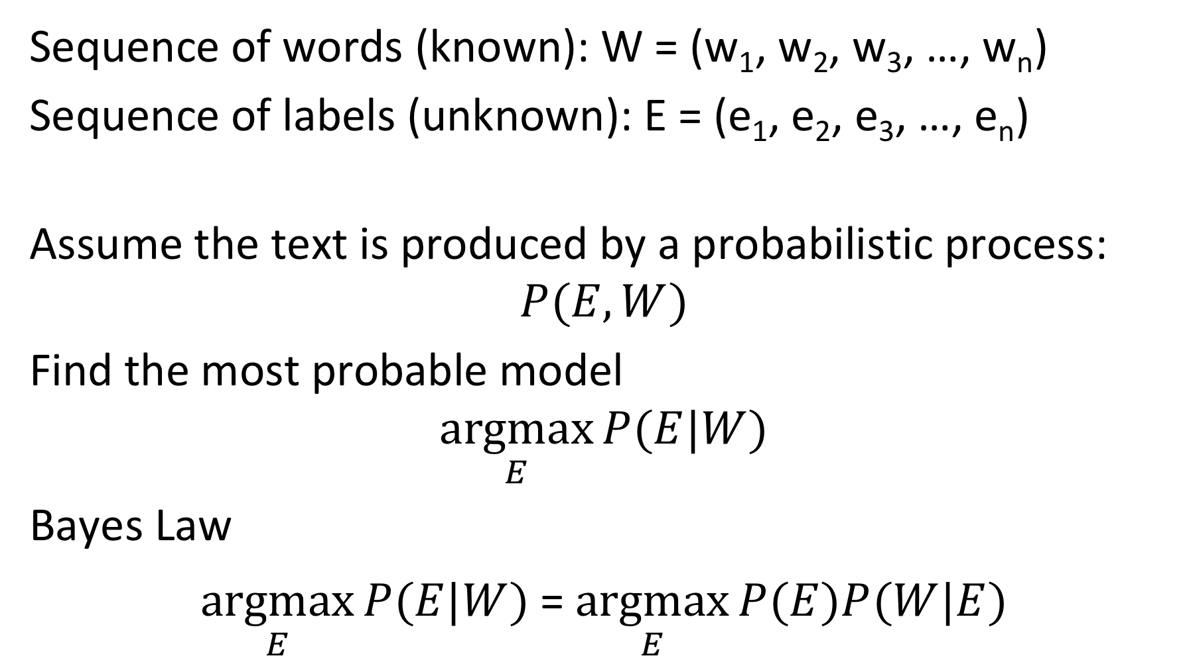
Generative Probabilistic Model
Sequence of words (known): W = (w₁, w₂, w₃, …, w_{n})
Sequence of labels (unknown): E = (e₁, e₂, e₃, …, e_{n})
Assume the text is produced by a probabilistic process:
$$P(E,W)$$
Find the most probable model
$$\underset{E}{argmax}{P(E|W)}$$
Bayes Law
$\underset{E}{argmax}{P(E|W)}$= $\underset{E}{argmax}{P(E)P(W|E)}$
Notes:
We now will see a classifier that specifically takes advantage of the sequential nature of learning entities in natural language text. The approach is strongly related to probabilistic information retrieval and based on a generative probabilistic model for text.
The basic model assumes that there exists a (unknown) probability distribution $P(E,W)$ that connects sequences of words with the corresponding sequences of labels. The task of classification is then to identify for a given sequence of words, the most probable sequence of labels given the sequence of words. Using Bayes law we can reformulate this, by decomposing the conditional probability $P(E|W)$ into the product of two probability distributions. P(E) is a model of how the different labels interact with each other, and P(W|E) is a model of how words interact with labels.

Slide 22
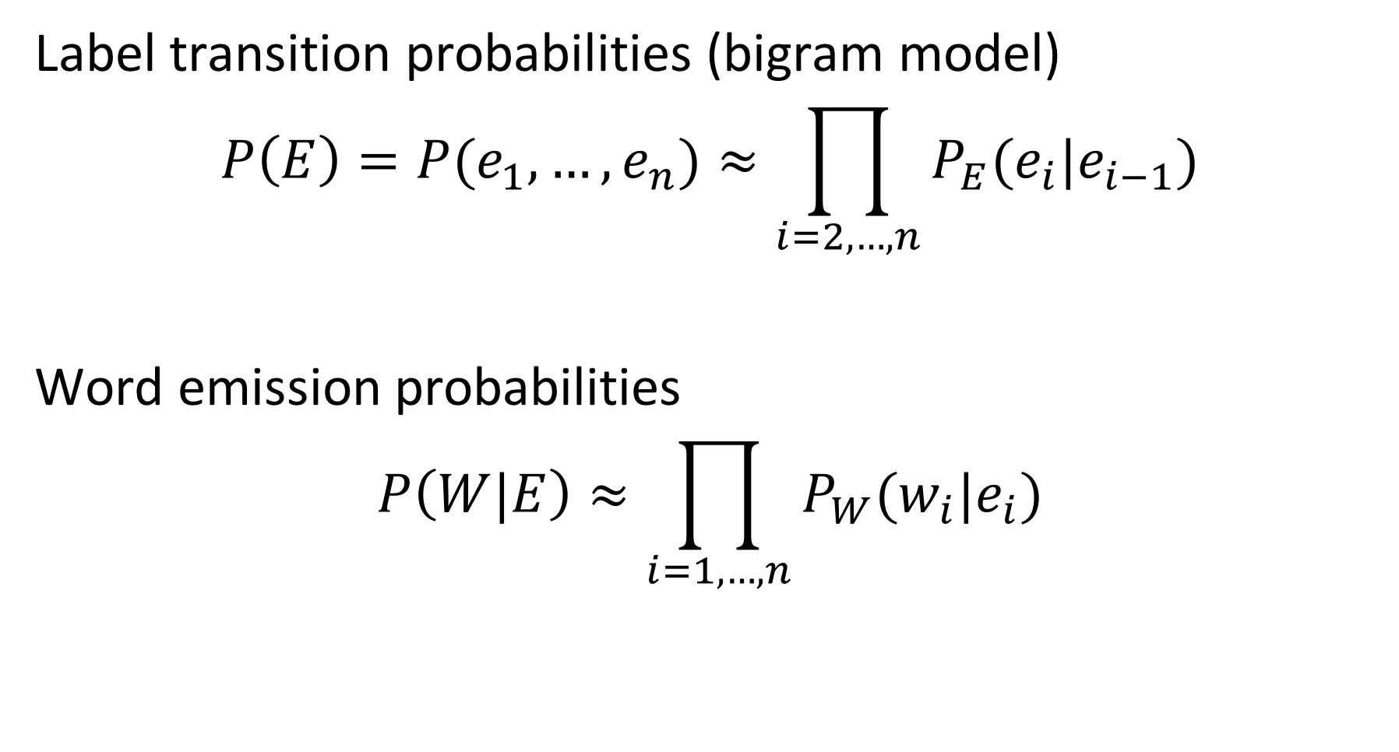
Approximation
Label transition probabilities (bigram model)
$$P\left(E\right)=P(e_{1},…,e_{n})≈\prod_{i=2,…,n}{P_{E}(e_{i}|e_{i−1})}$$
Word emission probabilities
$$P\left(W|E\right)≈\prod_{i=1,…,n}{P_{W}(w_{i}|e_{i})}$$
Notes:
As we will not be able to estimate the complete probability distribution functions, we approximate them by making (several) independence assumptions. We assume that the probability of a label to occur, depends only on the previous label. This corresponds to a bigram model (generalizing the unigram model we have assumed in probabilistic information retrieval). For words we assume that their probability depends only on the label that it received. Thus the two probability functions decompose into products of much simpler functions that we can estimate.

Slide 23
Hidden Markov Model (HMM)
Graphical representation of the approximate probabilistic model
EPFL
is
located
in
Lausanne
in
Switzer land
,
P_{W}(EPFL | I)
P_{W}(is| O)
P_{W}(located | O)
…
START
I
O
O
O
I
O
I
O
P_{E}(I | START)
P_{E}(O | I)
P_{E}(O | O)
P_{E}(O | O)
P_{E}(I | O)
P_{E}(O | I)
P_{E}(I | O)
P_{E}(O | I)
Maximum Likelihood Estimation
P_{E}(I | O) = 2 / 4 , P_{W} (in | O) = 2 / 5
Notes:
We can represent approximate model of the probability distribution graphically as a Markov Model, where we indicate which probabilistic variables depend on which others. More precisely, we have here the case of a hidden Markov model since the labels E are unknown and their probabilities need to be estimated from the known words.
The approach for HMM can be applied to any sequence labelling task. In particular it can be used to learn part-of-speech tags and the types of the entities.

Slide 24
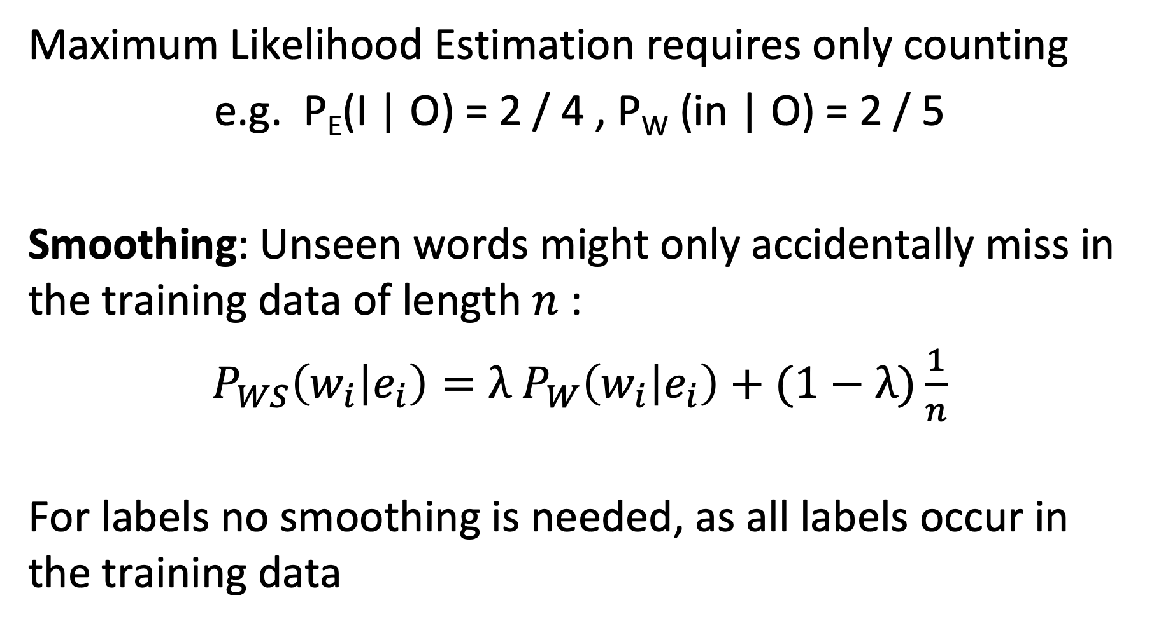
Learning the Model
Maximum Likelihood Estimation requires only counting
e.g. P_{E}(I | O) = 2 / 4 , P_{W} (in | O) = 2 / 5
Smoothing: Unseen words might only accidentally miss in the training data of length $n$:
$P_{WS}\left(w_{i} | e_{i}\right)=λ$ $P_{W}\left(w_{i} | e_{i}\right)+(1−λ)\frac{1}{n}$
For labels no smoothing is needed, as all labels occur in the training data
Notes:
For estimating the basic probabilities $P_{E}(e_{i}|e_{i−1})$ and $P_{W}(w_{i}|e_{i})$ we use maximum likelihood estimation as in probabilistic information retrieval. For example, for estimating a probability $P_{E}(e_{i}|O)$ we count the total number of occurrences of O, and then compute the ratio between the cases where the preceding label was I respectively O with the total number of occurrences.
As in probabilistic information retrieval we have the issue of sparsity of words in the training set. As a result it might occur that for a specific label no words appear as examples in the training data, whereas it is not excluded that such a word might be related to the label in general. With smoothing this is taken into account, where the smoothing parameter depends on the length of the word sequence.
For the labels no smoothing is required, as the number of labels is very small (in the case of untyped entity recognition it is 2) and thus all label combinations are extremely likely to occur.

Slide 25
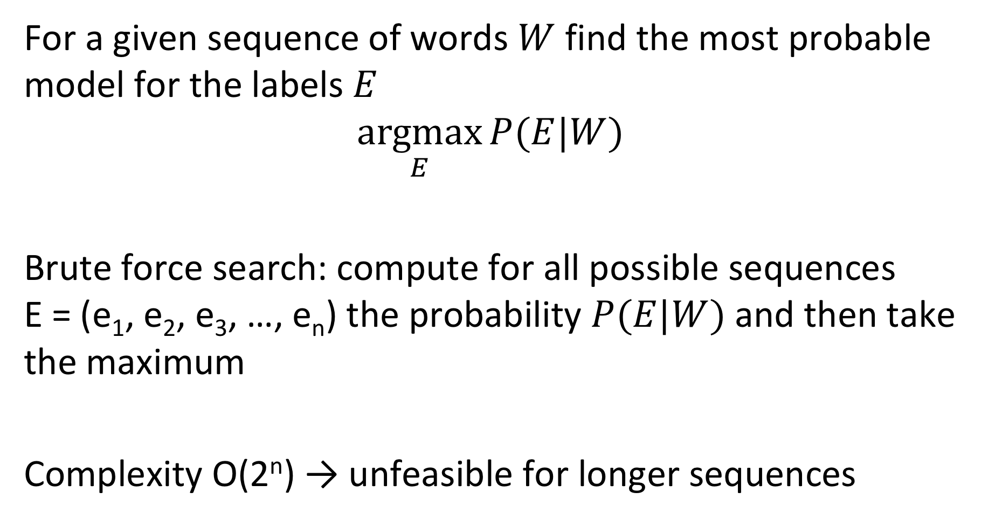
Using the Model
For a given sequence of words $W$ find the most probable model for the labels $E$
$$\underset{E}{argmax}{P(E|W)}$$
Brute force search: compute for all possible sequences E = (e₁, e₂, e₃, …, e_{n}) the probability $P(E|W)$and then take the maximum
Complexity O(2^{n}) → unfeasible for longer sequences
Notes:
For using the HMM Model the problem is of simply finding the sequence of labels that is the most probably one produced by the HMM for a giving sequence of words. In principle, this can be performed by brute-force search, but which does not scale for longer text due to a combinatorial growth in cost.

Slide 26
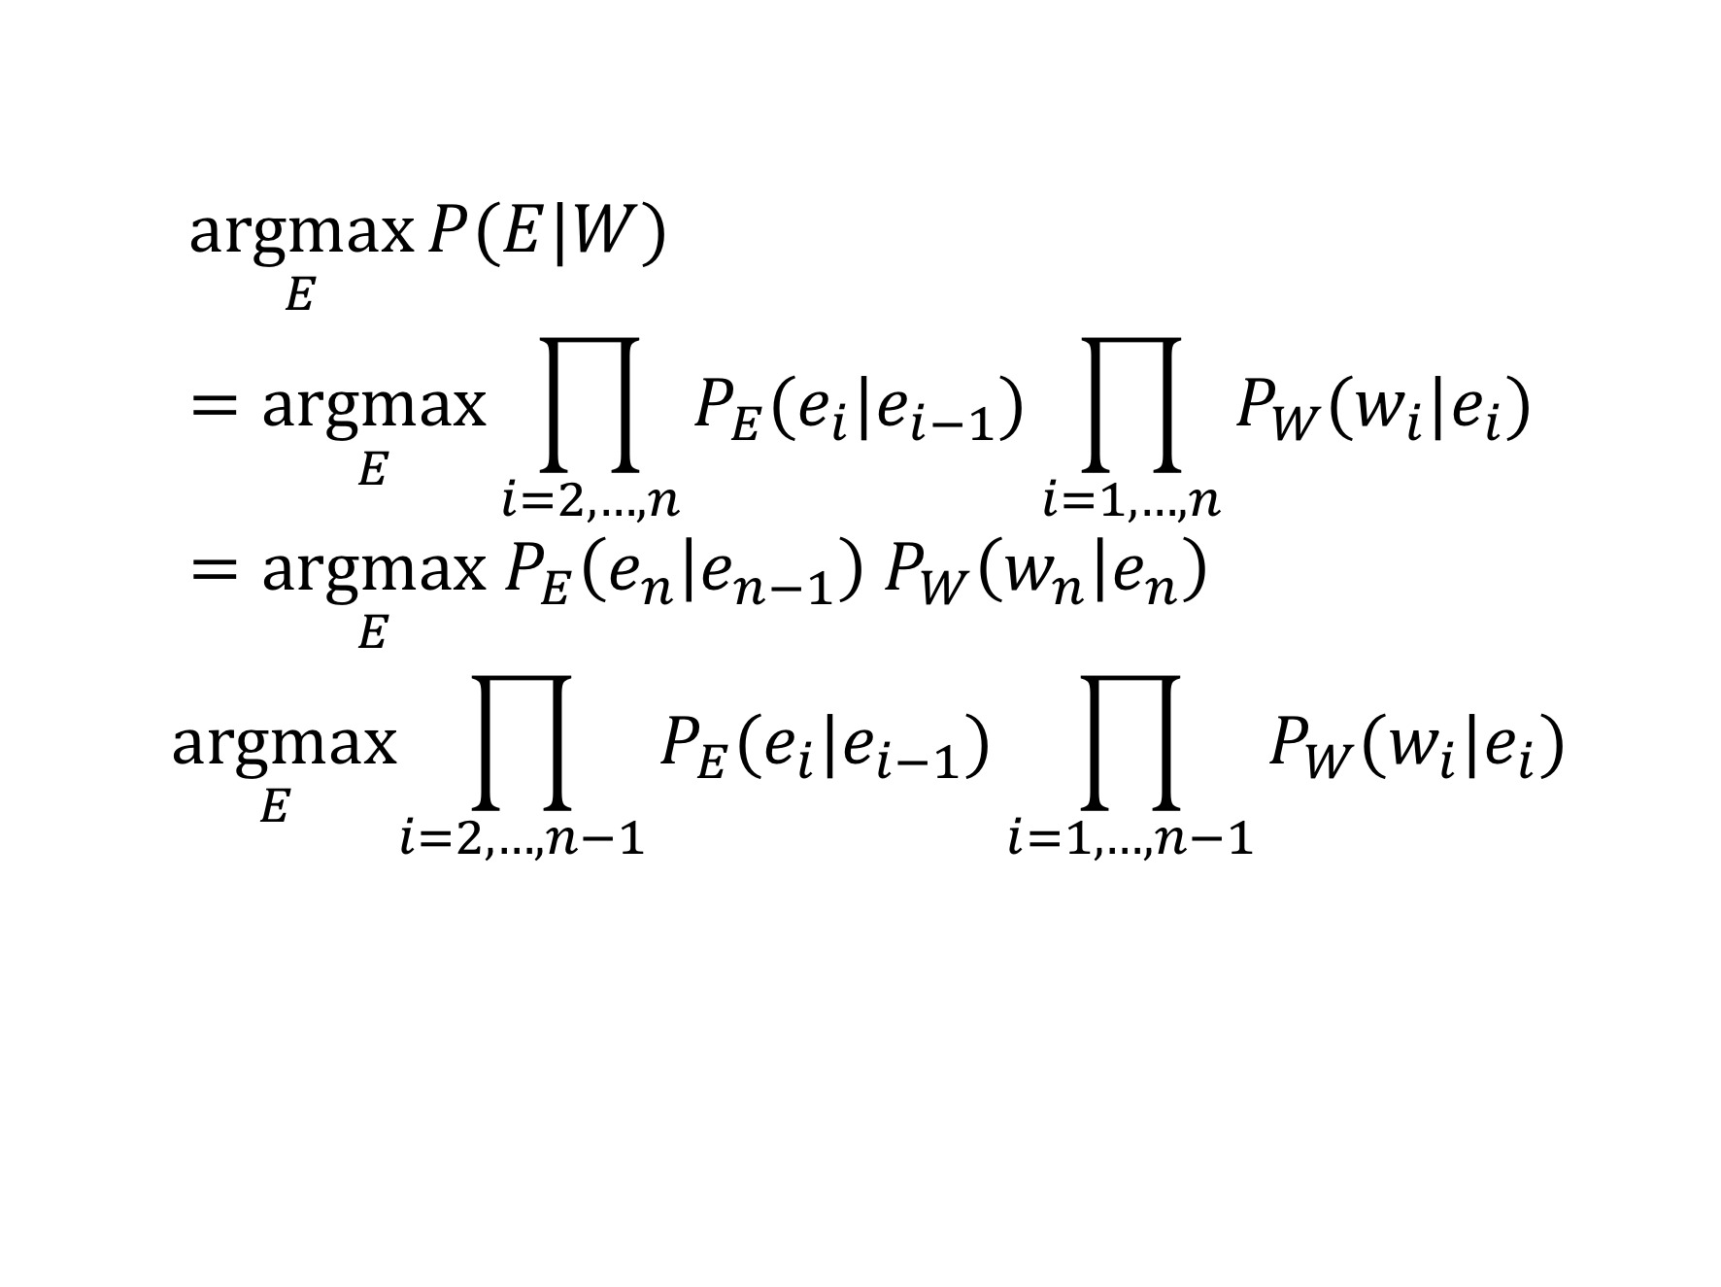
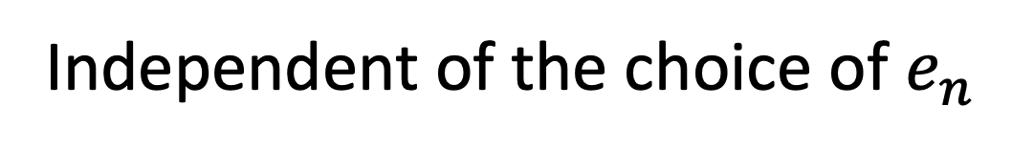
Observation
$$\underset{E}{argmax}{P(E|W)}=\underset{E}{argmax}\prod_{i=2,…,n}{P_{E}(e_{i}|e_{i−1})}\prod_{i=1,…,n}{P_{W}(w_{i}|e_{i})}=\underset{E}{argmax}{ P}_{E}\left(e_{n} | e_{n−1}\right) P_{W}\left(w_{n} | e_{n}\right)$$
$$\underset{E}{argmax}\prod_{i=2,…,n−1}{P_{E}(e_{i}|e_{i−1})}\prod_{i=1,…,n−1}{P_{W}(w_{i}|e_{i})}$$
Independent of the choice of $e_{n}$
Notes:
A simple observation is that the choice of the last label in a sequence that produces the largest probability can be made independently of the choices of the preceding labels that produce a maximal probability. Based on this observations the computation of the sequence with the maximal probability can be dramatically simplified.

Slide 27
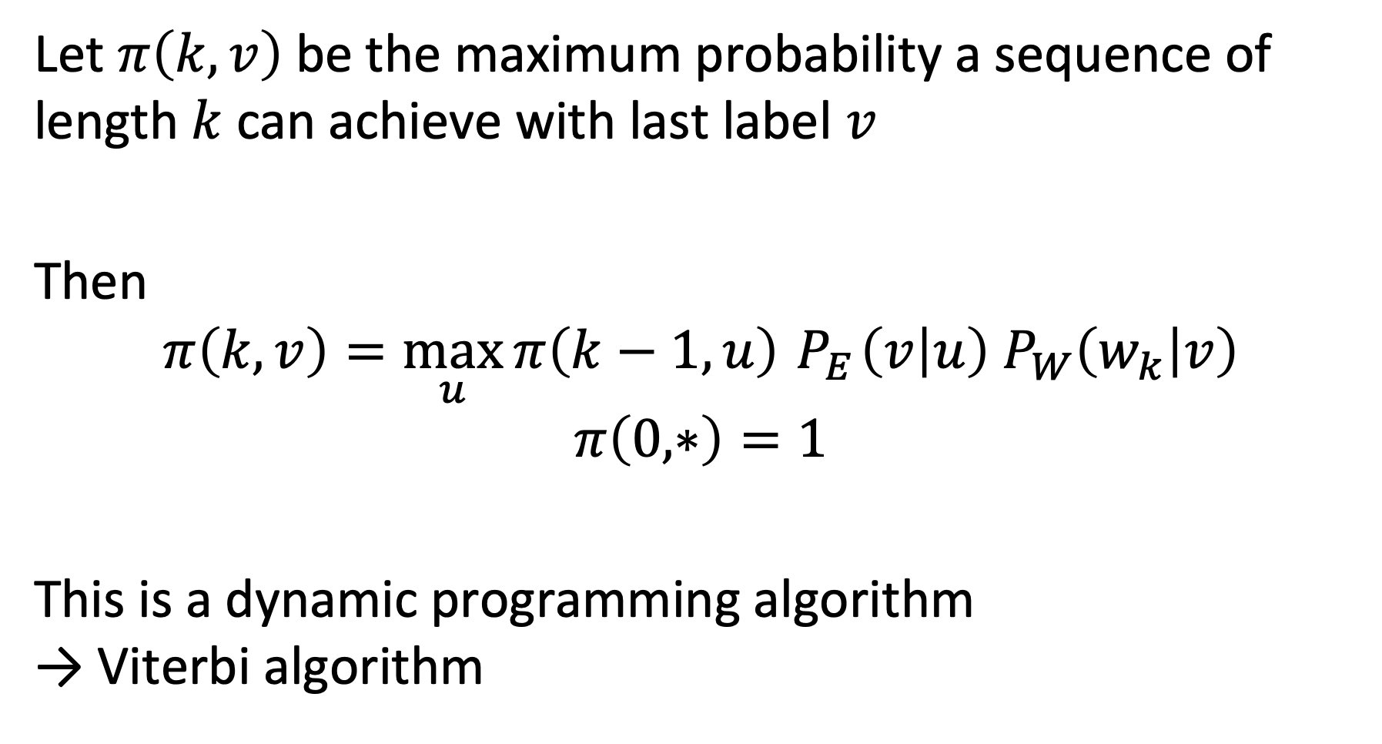
Viterbi Algorithm
Let $π\left(k,v\right)$ be the maximum probability a sequence of length $k$ can achieve with last label $v$
Then
$$π\left(k,v\right)=\max_{u}{π\left(k−1,u\right)}{ P}_{E}\left(v | u\right) P_{W}\left(w_{k} | v\right)$$
$$π\left(0,∗\right)=1$$
This is a dynamic programming algorithm → Viterbi algorithm
Notes:
It is just necessary to keep the information which is the sequence that produces the maximum value up to the last label, and then compute the label that maximizes this probability in the last step. In the case where the HMM model considers only the value of the previous label for predicting the next label this results in the above algorithm. In its generalized form, where labels can depend on multiple other labels (resp. random variables) the algorithm becomes a dynamic programming algorithm that is known as the Viterbi algorithm according to its inventor.

Slide 28
An HMM model would not be an appropriate approach to identify
Named Entities
Part-of-Speech tags
Concepts
Word n-grams

Slide 29
Which statement is correct?
The Viterbi algorithm works because words are independent in a sentence
The Viterbi algorithm works because it is applied to an HMM model that makes an independence assumption on the word dependencies in sentences
The Viterbi algorithm works because it makes an independence assumption on the word dependencies in sentences
The Viterbi algorithm works because it is applied to an HMM model that captures independence of words in a sentence

Slide 30
3. Information extraction

Slide 31
Information Extraction (IE)
Task: Extract statements from text → creation of knowledge graphs
EPFL is one of the two Swiss Federal Institutes of Technology. With the status of a national school since 1969, the young engineering school has grown in many dimensions, to the extent of becoming one of the most famous European institutions of science and technology. Like its sister institution in Zurich, ETHZ, it has three core missions: training, research and technology transfer. Associated with several specialised research institutes, the two Ecoles Polytechniques (Institutes of Technology) form the EPF domain , which is directly dependent on the Federal Department of Economic Affairs, Education and Research (EAER).
EPFL is located in Lausanne in Switzerland, on the shores of the largest lake in Europe, Lake Geneva and at the foot of the Alps and Mont-Blanc. Its main campus brings together over 11,000 persons, students, researchers and staff in the same magical place.
Notes:
Taking the analysis of documents one step further, we now consider the extraction of statements from natural language text, as is illustrated in the example. Statements connect entities through relationships, for example, the first statement expresses that EPFL is part of a larger organization, the Swiss Federal Institutes of Technology. Thus the notion of statements we use here corresponds exactly to the notion of statements we introduced earlier with RDF.

Slide 32
Sample Statements
EPFL is one of the two Swiss Federal Institutes of Technology
EPFL - IS-A - Swiss Federal Institute of Technology
its sister institution in Zurich, ETHZ
EPFL - RELATED-TO - ETHZ
EPF domain , which is directly dependent on the Federal Department of Economic Affairs
EPF Domain - DEPENDS-ON - FDEA
EPFL is located in Lausanne
EPFL – LOCATED-IN - Lausanne
Lake Geneva and at the foot of the Alps
EPFL – LOCATED-IN - Alps ? Lake Geneva – LOCATED-IN – Alps?
Notes:
Looking more closely at some of the statements we can extract from the text, we make the following observations. First, statements are always anchored in two entities, thus they link two entities by a relationship. Second, the relationships can carry different meanings, which in natural language are typically expressed in verbs. Third, the extraction of statements can be ambiguous. In the last example, when looking at the original text, the implied meaning is that EPFL is close to the alps. When looking only at the local context of ”Lake Geneva” and “Alps”, one might make also the (incorrect) inference that the statement is about Lake Geneva located in the alps. Accidentally this is not a wrong statement, but not the one that is intended in the text. So statement extraction can be a tricky task due to the ambiguity and complexity of human language.

Slide 33
Typed Statements
EPFL – PART-OF – Swiss Federal Institute of Technology
Type: ORG – PART-OF – ORG
EPFL – RELATED-TO – ETHZ
Type: ORG – RELATED-TO – ORG
EPF Domain – PART-OF – FDEA
Type: ORG – PART-OF – ORG
EPFL – LOCATED-IN - Lausanne
Type: ORG – LOCATED-IN – LOC
EPFL – LOCATED-IN - Alps ? Lake Geneva – LOCATED-IN – Alps?
Type: ORG – LOCATED-IN – LOC
Type: LOC – LOCATED-IN – LOC
Notes:
We can from the individual statements generalize to the statements with the type of entities, resulting in statement types. This implies that we may assume the existence of a schema for statements (in RDF an RDF schema) that specifies which types of entities can be connected by which types of relationships. Not every type of entity can be related in a meaningful way to another type of entity. For example, it would not make sense to have a statement expressing that a location is part of a person. Having these additional constraints, will be helpful to more precisely detect statements.

Slide 34
Statement Schema
PART-OF
PART-OF
ORG
LOC
LOCATED-IN
RELATED-TO
Notes:
This is an example of a possible schema that constrains the type of statements to be considered.

Slide 35
Approaches to Information Extraction
Hand-written patterns
Supervised machine learning
Bootstrapping
Distant supervision
Matrix Factorization

Slide 36
1. Hand-Written Patterns
Early approach from Hearst (1992)
“Agar is a substance prepared from a mixture of red algae, such as Gelidium, for laboratory or industrial use”
Patterns to detect IS-A relationships:
“Y such as X ((, X)* (, and|or) X)”
“such Y as X”
“X or other Y”
“X and other Y”
“Y including X”
“Y, especially X”
Notes:
A first approach to statement extraction is based on the observation that in natural language often a relationship is expressed in a regular fashion. Very early on, this has been used to extract specific relationships, such as ISA, by using regular expression patterns. Hearst was one of the first attempts taking this approach, and the method is still being used till today, potentially with some expanded set of patterns.

Slide 37
Web isa Database
Large scale extraction of IS-A relationships from web documents
http://webdatacommons.org/isadb/
Notes:
Web is a DB is an example a large-scale effort to extract IS-A relationships from Web data. The patterns are more complex than the ones introduced by Hearst.

Slide 38
More General Hand-Written Patterns
Idea: relations often hold between specific entity types
located-in (ORGANIZATION, LOCATION)
founded (PERSON, ORGANIZATION)
cures (DRUG, DISEASE)
First, perform Named Entities Recognition
Use typed pattern: ORG is located in LOC, LOC
EPFL is located in Lausanne, Switzerland
Notes:
The idea of Hearst that has been successfully applied for detecting ISA relationships, can be extended to patterns of a more general type, for extracting statements for other types of relationships. I this approach, one can exploit the fact that certain relationships can only hold among certain types of entities. Thus in a first step a named entity recognition is performed, and subsequently the patterns are searched for which the matching types of entities can be found.

Slide 39
Summary Hand-Written Patterns
Advantages
Rules tend to be high-precision
Can be tailored to specific domains
Disadvantages
Human patterns are often low-recall
A lot of effort to think of all possible patterns
Notes:
Hand-written patterns are in general a very reliable method for statement extraction. However, it suffers from low recall and it is very difficult to conceive all possible patterns by a human (expert). Therefore more automated methods are of interest, that we will discuss in the following.

Slide 40
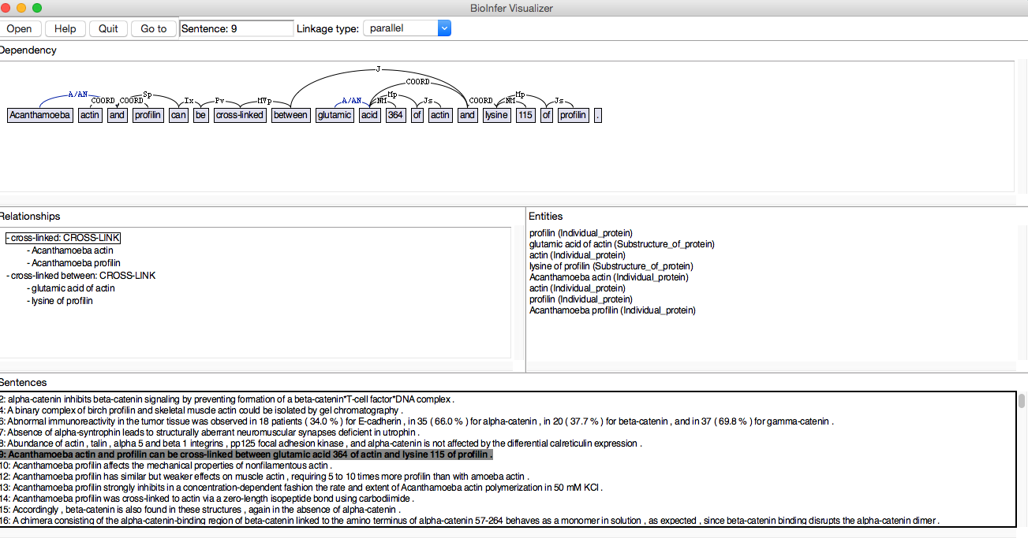
2. Supervised Learning for IE
Approach: train a classifier on labeled data
Creating a training set
Choose relevant named entities and their relations
Hand-label relations among entities (positive examples)
http://mars.cs.utu.fi/BioInfer/
Notes:
The supervised learning approach for information extraction requires first a training set. Producing such a training set is labor-intensive and a major task. For example, for the domain of life sciences efforts have been undertaken. In the example shown, more than 2000 sentences have been manually annotated.

Slide 41
Classifiers for Information Extraction
Two-step approach
A filtering classifier (e.g., Naïve Bayes), to detect whether a relation exists among the entities
A relation-specific classifier detecting the relation label
Training the classifiers
Extract named entities in the document corpus using NER
Detect pairs of entities, e.g., in the same sentence
Use unlabeled entity pairs as negative examples
Notes:
Once a manually annotated document collection is available, classifiers for information extraction can be trained. One approach is to train two types of classifiers, one that simply detects whether a relationship exists among two entities, and a second that detects the type of the relationship. The use of a filtering classifier can speed up the classification task and allows the use of distinct feature-sets for the two tasks.
For training the classifiers, one first extracts all entity pairs using NER that occur in the same context, for example, in the same sentence. If the pairs are not annotated they are taken as negative examples. Then the classifier is being trained using features extracted from the context of the occurrences of the entities.

Slide 42
Features Used in IE
EPFL is located in Lausanne in Switzerland, next to Lake Geneva
Features for mention (M1, M2) = (Lausanne, Lake Geneva):
BOW and bigrams in the sentence: is, located, in, located in, Lausanne, in, next to …
BOW and bigrams in between the mentions: in, Switzerland, next, to, next to
Headwords* of mentions, their concatenation: Lausanne, Geneva, Lausanne-Geneva
Words in positions: M1-1: in, M1+1: in, M2-1: to
Types of entities LOC, LOC
Stemmed version of the words
Syntactic features
…
*headword = entry in a dictionary
Notes:
The features being used for information extraction are typically different from the ones used for NER. When we have identified two occurrences of named entities in a sentence, also called two mentions (M1, M2), then we can identify the following features related to the two mentions:
The bag of words and bigrams found within the whole sentence
Distinct from that the BOW and bigrams in between the mentions
The headwords (these are words that are typically found in a standard dictionary)
Words in specific position with respect to the mentions
Stemmed versions of all the words above
The type of entities used
Syntactic features, extracted with part-of-speech analysis

Slide 43
Syntactic Features
Parse Tree
(S (NP EPFL) (VP is (VP located (PP in (NP Lausanne))
(PP in (NP Switzerland ,
(PP next to
(NP Lake Geneva)))))))
Features:
Sequence between entities: PP NP PP NP
Notes:
The syntactic features, or part-of-speech tags can be exploited in various ways. In the simplest case only the sequence of POS tags in between the mentions is used. More complex features can be constructed as well, e.g. the navigation path between the mentions in the parse tree. For trying out POS tagging you can try: https://www.link.cs.cmu.edu/link/submit-sentence-4.html

Slide 44
Which is true?
Hand-written patterns are in general more precise than classifiers
Hand-written patterns cannot exploit syntactic features
Supervised classifiers do not require any human input
Supervised classifiers can only detect typed statements

Slide 45
3. Bootstrapping
No training data, but a few high-precision patterns
Approach:
Find entity pairs that match the pattern
Find sentences containing those entity pairs
Generalize the entities in those sentences
Generate new patterns
Notes:
One of the big problems with supervised approaches to information extraction is the scarcity of training data. One way to approach this problem is called bootstrapping. The basic idea is that one may have a few high-precision patterns, such as the Hearst patterns, or simple a set of example statements that are manually extracted, and one tries to generalize these patterns by analyzing a large document corpus.
The approach is to first find entity pairs using the high precision patterns. Then using those entity pairs sentences containing the same entity pairs are searched. The assumption is that with large likelihood these sentences express the same type of relationship, just in a different syntactic representation. Thus such sentences can be considered as templates for expressing the relationship. By generalizing the occurrences of the entities in such a sentence, now patterns for identifying the relationship are produced.

Slide 46
Example
Document corpus
1. Entity pairs matching P1:
(e1,e2) (e3,e4) (e7,e8)
P1,e1,e2
P1,*,*
P1,e3,e4
P2,e1,e2
P2 derived from P1
P2,e5,e6
2. Matching entity pairs with pattern P2:
(e1,e2) (e3,e4)
P2 possible new pattern
P2,*,*
P1,e7,e8
3. New entity pair discovered with P2:
(e5,e6)
P2,e3,e4
Notes:
This graphics illustrates the different steps of how new patterns are detected and applied to find new relationships.

Slide 47
Example
Pattern: LOC is located in LOC
Mumbai is located in India
Adelaide is located in Southern Australia
Sriharikota is located in Nellore
Search for entity pairs (Mumbai, India)
Mumbai is India's top destination
Mumbai hotels, India
New patterns
LOC is LOC’s top destination
LOC hotels, LOC
Notes:
This example illustrates the approach. We start with a simple, but precise pattern, LOC is located in LOC, with which we find occurrences of entity pairs. Then we search for those entity pairs, and find other sentences mentioning them. These are then generalized to patterns by replacing the entity occurrences by their types.

Slide 48
Problem: Semantic Drift
Example: The pattern LOC hotels, LOC matches also
… Geneva hotels, Lausanne hotels …
➔ Geneva is located in Lausanne?
Notes:
Of course, this approach risks to infer wrong rules for many reasons. For example, by matching the patterns without considering the context wrong inferences as the one shown in this example could be made.

Slide 49
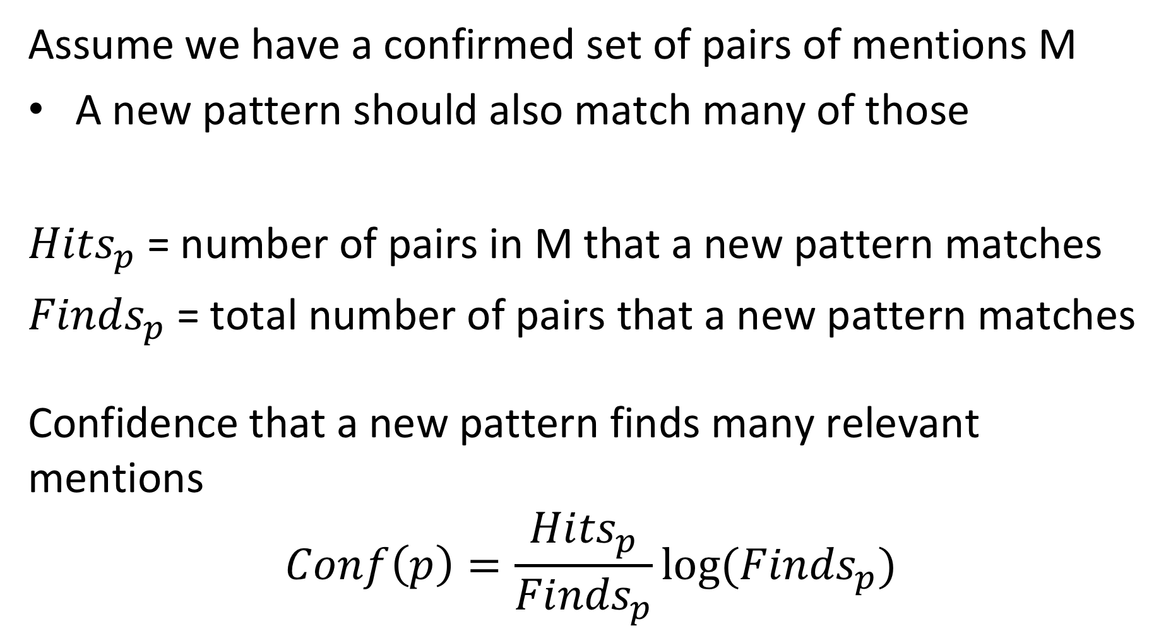
Confidence
Assume we have a confirmed set of pairs of mentions M
A new pattern should also match many of those
${Hits}_{p}$ = number of pairs in M that a new pattern matches
${Finds}_{p}$ = total number of pairs that a new pattern matches
Confidence that a new pattern finds many relevant mentions
$$Conf\left(p\right)=\frac{{Hits}_{p}}{{Finds}_{p}}log⁡({Finds}_{p})$$
Notes:
In order to contain the problem of inferring too many ”wrong” patterns, a confidence metric can be used. With this metric the confidence in a new template increases, whenever it retrieves more entity pairs that are already confirmed to be correct. However, this is balanced by measuring of how many entity pairs the new template matches in total. If in proportion it matches too many pairs, without creating confirmed entity pairs, the confidence in the template is lowered.

Slide 50
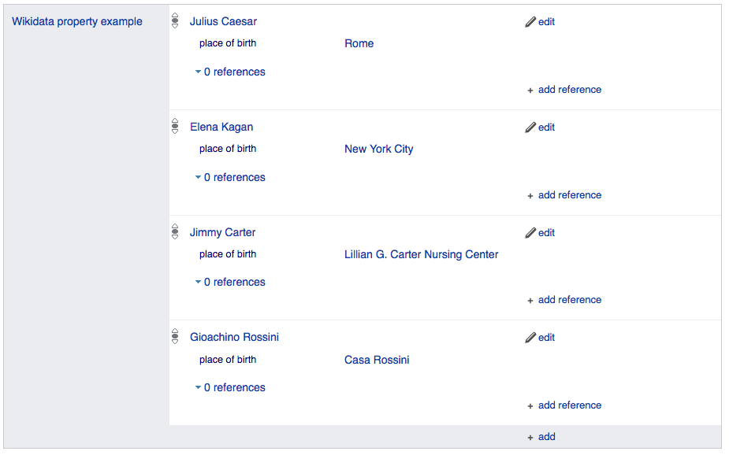
4. No Training Data? Distant Supervision
Idea: use existing knowledge bases to collect training data for building a classifier
Combines advantages of bootstrapping with supervised learning
Example: learning PLACE-OF-BIRTH
For example, WikiData has many positive examples!
Notes:
Another idea to deal with the problem of lacking training data is based on the observation that large databases of known statements (also called facts) do exist. One example is WikiData. Thus, instead of producing confirmed statements from a training corpus by using high precision patterns, such statements are drawn from an existing knowledge base. In this way, large document collections can be searched for sentences that potentially express those facts, and these sentences can be used to train a classifier for information extraction.

Slide 51
Linking Text to Knowledge Bases
Using Entity extraction, entity mentions in text can be linked to corresponding mentions in a knowledge base
John was born in Liverpool, to Julia and Alfred Lennon
Entities |  | Text Features (e.g. pattern) |  |  | Relation from knowledge base
Entity 1 | Entity 2 | PER was born in LOC | PER was born to PER | PER and PER | Birthplace(X,Y) | Married(X,Y)
John Lennon | Liverpool | x |  |  | ?
John Lennon | Julia Lennon |  | x
John Lennon | Julia Lennon |  | x
Julia Lennon | Julia Lennon |  |  | x |  | ?
Barack Obama | Hawaii | x |  |  | x
Barack Obama | Michelle Obama |  |  | x |  | x
Barack Obama was born in Hawaii. Barack and Michelle Obama …
Notes:
In this example we illustrate of how entity pairs identified in text can be linked to the same entity pairs as they are found in a knowledge base. This enables to reason about the meaning of certain syntactic patterns (e.g. ”was born in”) and infer what their formal meaning could be (e.g. birthplace).

Slide 52
Distant Supervision: Approach
(s, ent1, ent2)
Wikipedia
Run NER and extract all entity pairs in sentences
Check whether a relation among the entities exists in the database
Training Data
(ent1, ent2, rel, features)
Predict label for new sentences:
(s, ent1, ent2, rel?)
WikiData
For entities with relations extract features from the sentence
Train a classifier to predict the relation from the features
Notes:
Here we illustrate the process of the distant supervision method. First, we start by running NER over a large document collection, such as WikiPedia. This produces a set of sentences s that contain entity pairs (e1,e2). Having those entity pairs, next we check in the existing knowledge base, in this example WikiData, whether relations among the entity pairs exist. For those entity pairs, for which a relation is confirmed in the knowledge base, we have identified an instance for the training data, and we extract all typical features used for information extraction from the sentence in which the entity pair has been found. This produces a training set for training a classifier to predict the relation. Finally this classifier can be used to predict relations for unseen documents, by extracting occurrences of entity pairs and feeding the classifier with the features of the sentence in which they are contained.

Slide 53
Features for Distant Supervision
Use conjunctions of standard IE features as sentence features
Match only if all individual features match
High precision, but low recall features!
Feasible, since training set is large
Complex features resemble to templates used in rule-based approaches
Notes:
In distant supervision the features are constructed in a different way than in standard information extraction using supervised learning, due to the fact that the number of training examples is in general much higher. Instead of producing a feature vector from combining all individual features, each feature combination is considered as a separate feature, which results in a much larger feature space. As a result, those more complex features are much more precise, but have low recall. This is, however, compensated by the fact that the training set is much larger.

Slide 54
Example
Complex Features for “EPFL is located in Lausanne in Switzerland”:
F0: M1=ORG and M2=LOC and betweenwords={is, located, in} and afterwords={} and betweenPOS = {VP, VP, PP}
F1: M1=ORG and M2=LOC and betweenwords={is, located, in} and afterwords={in} and betweenPOS = {VP, VP, PP}
→ F0 matches “ETHZ is located in Zürich, Switzerland”, F1 not
Individual features:
F1: M1=ORG, F2: M2=LOC, F3: betweenwords={is, located, in} , F4: afterwords0={}, F5: afterwords1={in}, F6: betweenPOS = {VP, VP, PP}
→ only F5 is different
Window size 0
Window size 1
Notes:
The example illustrates this point. We construct two complex features by computing the conjunction of several simple features, once considering a window of size 0 around the phrase containing the entities (resulting in feature F0) and once considering a window of size 1 around the phrase containing the entities (resulting in feature F1). As a result, the complex feature F1 does not match at all the sentence “ETHZ is located in Zürich, Switzerland”.
If used a feature vector derived from the individual features, the two feature vectors derived for the two documents would be very similar for these feature set, since most of the features are identical. Only feature F5 would be different.

Slide 55
Which is true?
Distant supervision requires rules for bootstrapping
Classifiers produced with distant supervision are more precise than rules
Distant supervision can help to detect rules

Slide 56
5. Matrix Factorization
Using the same data as for distant supervision
Entity pairs from text linked to relations from knowledge bases
Instead of learning a classifier, create low-dimensional representations for entity pairs and relations
Use those representations to
Link text patterns to relation types and identify similar text patterns
Extract relations from text
Notes:
Distant supervision aims at generating classifiers for relations that are based on syntactic features. With the same information used for distant supervision we could also try to understand the intrinsic nature of relationships by mapping them to a low-dimensional representation, as we did earlier for words with word embeddings. This is the idea underlying to apply matrix factorization ot the entity-pairs / relation matrix.

Slide 57
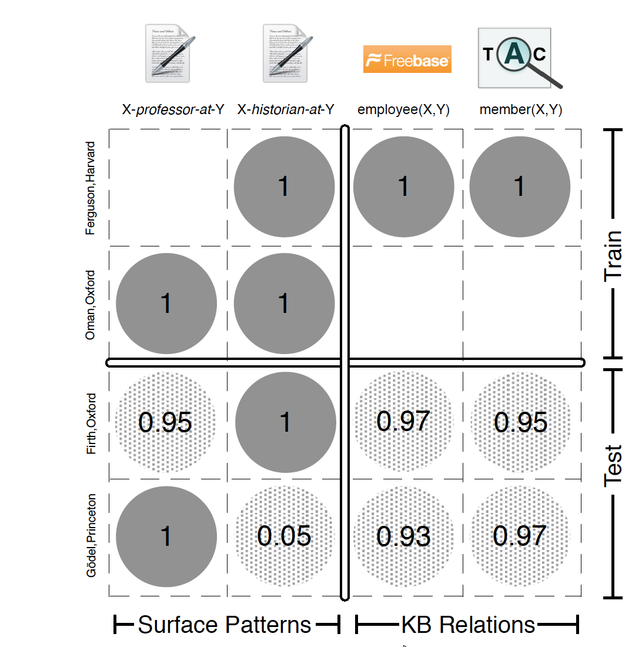
Matrix Representation
Create a matrix with
Entity pairs as rows
Relation types as columns
Relations from text patterns
Relations from knowledge base
The entity-pair/relation matrix is a sparse matrix (like in recommender systems)
Notes:
By using matrix factorization the hope is to align similar text patterns and corresponding relationships in a latent space. This can help both in identifying text patterns that correspond to relationships and to extract those relationships from text.
The entity-pair/relation matrix is a sparse matrix. Thus situation is comparable to the one we had in recommender systems. Algebraic factorization methods would not work. On the other hand using matrix factorization based on SGD might help to “guess” new relationships (as in recommender systems it helps to guess unseen ratings). This idea we will alter exploit also for the problem of link prediction.

Slide 58
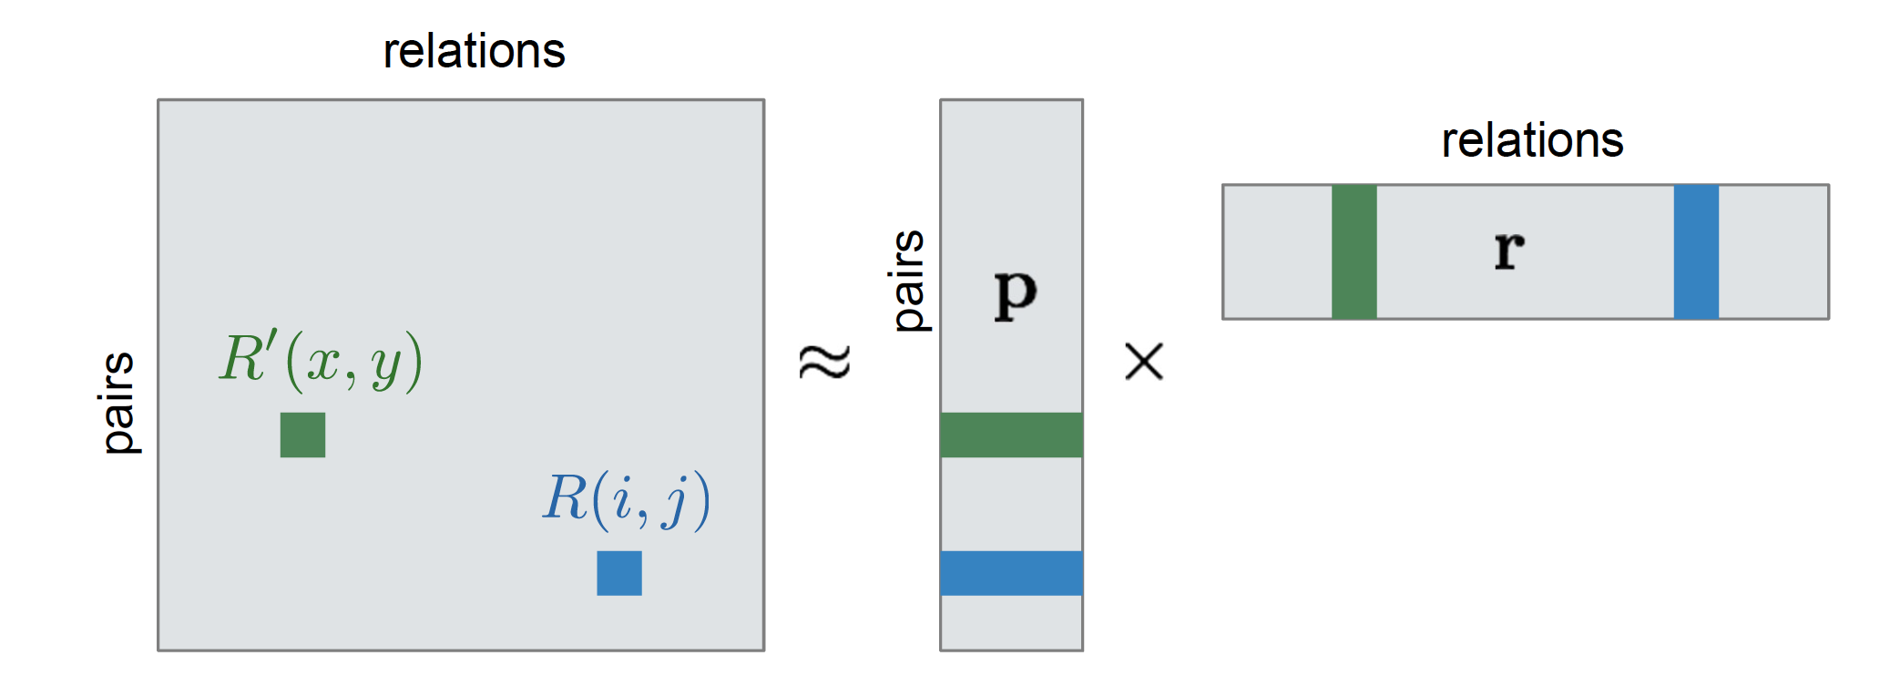
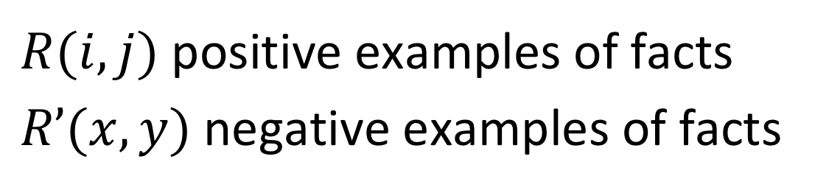
Matrix Factorization
$R(i,j)$ positive examples of facts
$R’(x,y)$negative examples of facts
Notes:
The matrix factorization will represent both entity pairs and relations as low-dimensional vectors in a latent space. The entries in the matrix will be the corresponding scalar products. The entries in the matrix are high probabilities if a relationship holds, and low probabilities if this is not the case.
From distant supervision and text analysis we have positive examples. For learning we also need negative examples.

Slide 59
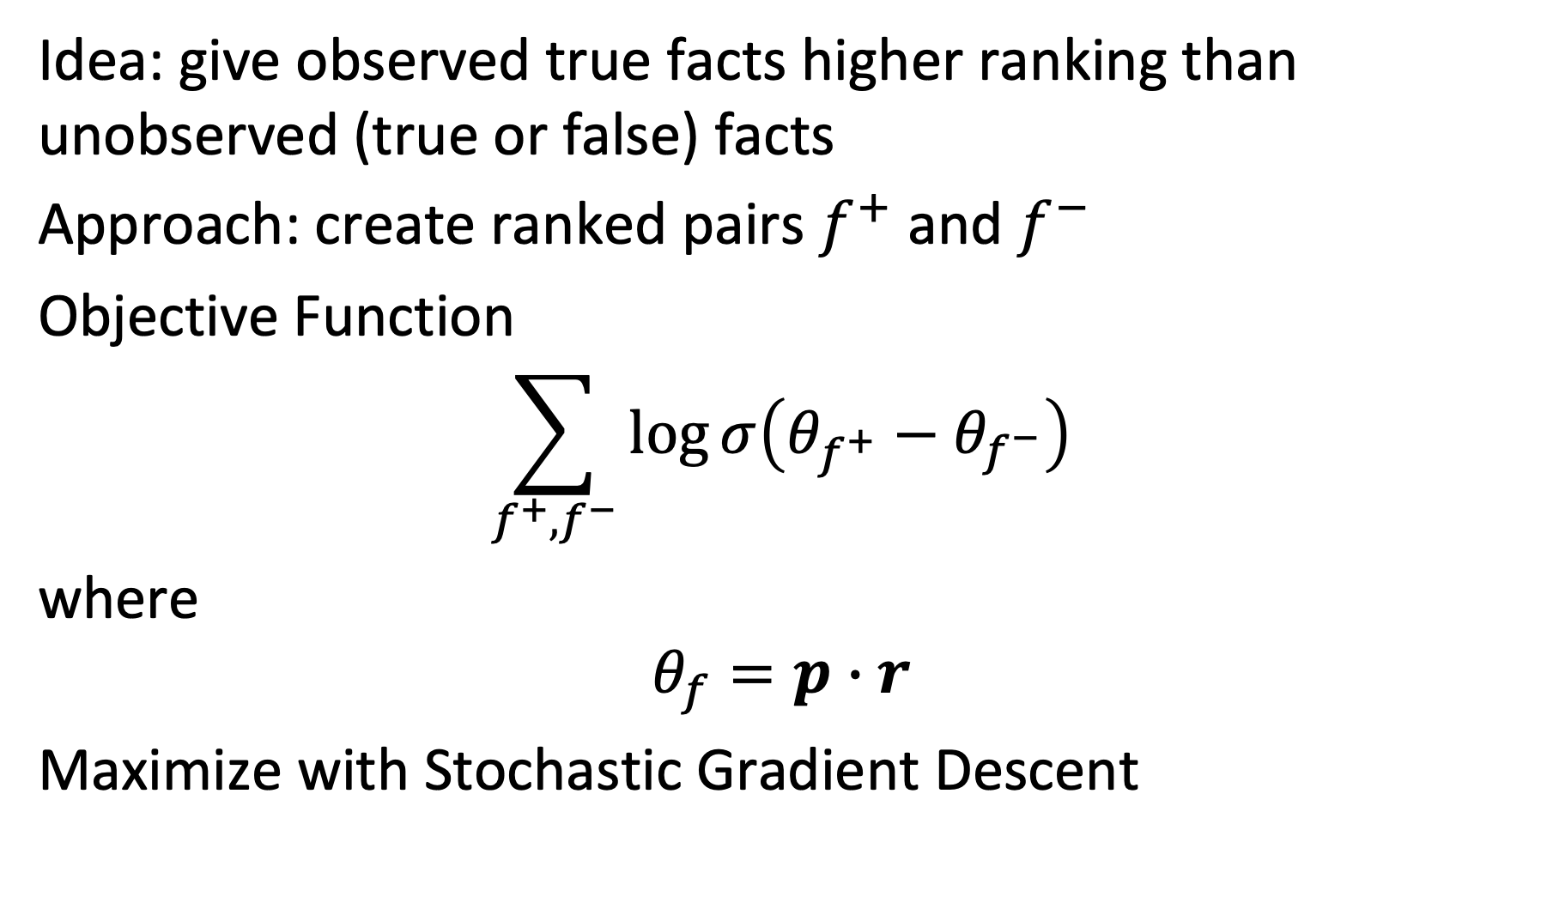
Bayesian Personalized Ranking
Idea: give observed true facts higher ranking than unobserved (true or false) facts
Approach: create ranked pairs $f^{+}$ and $f^{−}$
Objective Function
$$\sum_{f^{+},f^{−}}{\log{σ\left(θ_{f^{+}}−θ_{f^{−}}\right)}}$$
where
$$θ_{f}=p∙r$$
Maximize with Stochastic Gradient Descent
Notes:
For choosing negative examples of facts we encounter the problem that we can choose any fact that has not been observed in the data as such a negative example, but that we cannot be sure that the chosen example really is a negative example. It could simply be a relationship that holds, but has not been registered anywhere. This problem is similar to the one encountered in recommender systems where the absence of a rating does not imply a negative rating.
To better adjust to this situation an alternative method for matrix factorization, called Bayesian Personalized Ranking, is used. It is based on an alternative loss function is constructed that attempts to maintain the relative ranking among positive and negative examples.

Slide 60
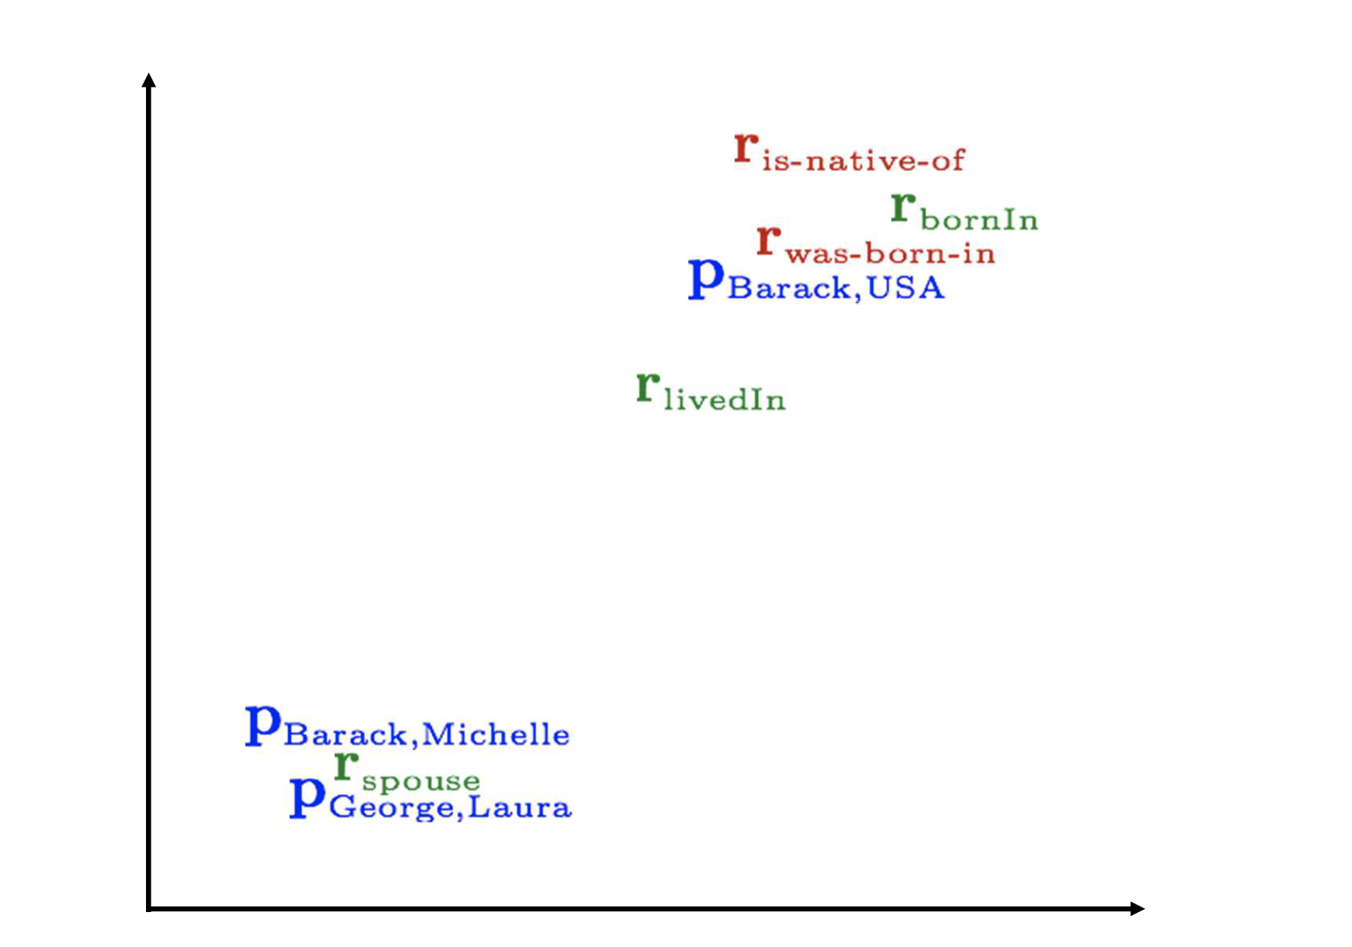
Relation Embeddings
Notes:
The matrix factorization obtained this way allows to map entity pairs and relationships in the same low-dimensional space. As illustrated in this example this should cluster together those that correspond to similar relationships. This allows to infer new relationships for existing entity pairs, as well as syntactic forms of relationships.

Slide 61
Exploiting Relation Embedding Similarity
Similar in embedding space
Entities |  | Relationship pattern
Entity 1 | Entity 2 | COM owns part in COM | COM buys stake in COM
Renault | Nissan | x | x
BMW | Rover |  | x
Volkswagen | Porsche
Ford | Toyota
Similar in embedding space
Possible inferences:
BMW owns part in Rover (similarity of relationship)
Volkswagen owns part in Porsche (similarity of entity pair)
Notes:
This example illustrates of how the method could be used to extract relationships for previously unknown syntactic patterns.

Slide 62
Summary
Information extraction
Populating knowledge bases and fact databases
Taxonomy induction
Pattern-based approaches
High precision, low recall, work intensive
Supervised learning
Low precision, high recall, work intensive
Hybrid methods: bootstrapping, distant supervision, matrix factorization
No statement schema known: open information extraction
Notes:
We have discussed the different variants of information extraction methods typically used, with their advantages and drawbacks. Another problem of information extraction is called open information extraction. It is typically used for extracting statements from large collections of documents, such as the Web, where no predefined schema of relations and entity types is known. Such methods have first of all to be able to identify that a statement is present. Such methods rely on significant syntactic preprocessing of the text, and use verbs as anchor points to detect statements.

Slide 63
4. Taxonomy induction

Slide 64
Taxonomy Induction
Information extraction
Extract isolated facts from documents, e.g., lion ISA animal
Taxonomy induction
Extract related facts from documents, e.g., classification of animals
Notes:
Information extraction concerns the extraction of isolated facts, such as ISA relationships. Taxonomy induction aims at extracting related facts and organizing them in a structured knowledge basis, e.g. a hierarchical taxonomy. It is a special case of the more general ontology induction, which organizes knowledge using arbitrary relationships.

Slide 65
Use of Taxonomies
Hyponyms (subordinate terms) can inherit properties from hypernyms (more general terms)
Due to transitivity of ISA, no need to learn inferred facts
No unique taxonomies
Depending on the perspective and application different taxonomies may be useful:
A tiger and a puppy are both Mammals and hence belong close together in a typical taxonomy, but tiger is a WildAnimal (in the perspective of Animal-Function) and a JungleDweller (in the perspective of Habitat), while a puppy is a Pet (as function) and a HouseAnimal (as habitat), which would place them relatively far from one another
Notes:
One of the advantages of taxonomy induction (and more generally ontology induction) is the possibility to perform inferences on the extracted knowledge. For example, in a ISA hierarchy, lower nodes in the hierarchy can inherit properties from higher nodes, thus these extra facts need not to be learnt separately.
One of the challenges in taxonomy induction is the fact that there is no notion of “correct” taxonomy. A taxonomy strongly depends in its intended use and on the specific perspective of the user on the domain. Integrating all possible perspectives into one single global taxonomy would not be feasible and useful, as the resulting taxonomy would potentially be too complex to be used.

Slide 66
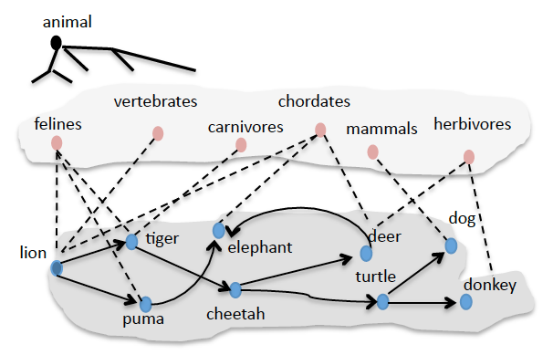
Taxonomy Induction Task
Starting from a root concept and a basic concept
Learn relevant terms and their hypernym / hyponym relationships
Filter out erroneous terms and relations
Induce a taxonomy structure
Notes:
We present in the following one specific approach to taxonomy induction, which was one of the first approaches proposed in the field. It starts from the assumption that one general concept (e.g. animals) and at least on basic concept of the taxonomy (e.g. lion) are provided as input. From this starting point the task is to identify more relevant concepts (represented as terms), establish the hypernym and hyponym relationships, filter out erroneous terms and relations and finally induce an overall taxonomy structure. The figure illustrates the process: at the bottom level first more related terms are identified. Then intermediate concepts, more abstract than the basic concepts are identified. From this data finally the taxonomy will be induced.

Slide 67
Learning Terms
Template approach: double-anchored patterns
Given a root concept c (e.g. animal) and a seed s (e.g. lion)
Hyponym pattern, detecting instances: P_{i}(c, s, X) = c such as s and X
Hypernym pattern, using known instances t₁ and t₂, detect classes: P_{c}(t₁, t₂, X) = X such as t₁ and t₂
Notes:
The basic idea is to learn terms and relationships by querying a Web search engine. As patterns language template capturing hypernym relationships are used. This is analogous to the approach with Hearst patterns for extracting ISA relationships. However, as in a first phase on has to detect more relevant terms, so-called double anchored patterns are used, that relate one (known) term to another (unknown) term of the same class of concepts. One example of such a pattern would be “c such as s and X”, where c and s would be known and from the result the term at position X would be a new term from the same class of concepts as c. Using such patterns new terms can be harvested by recursively applying the pattern to the terms known so far.
The indices i and c in P_{i} and P_{c}, refer to the fact that the patterns are used to detect instances and classes respectively.

Slide 68
Finding Hyponyms
Recursively harvest new terms using a Web search engine
T = {s}; w(t) = 0
while T changes
for all t in T: submit P_{i}(c, t, X) to search engine
if result is not empty
add to T all new terms t_{new} found in position X in a result
w(t)++
Notes:
We keep a weight w(t) that will allow us later to know whether a given term has led to the discovery of another term.

Slide 69
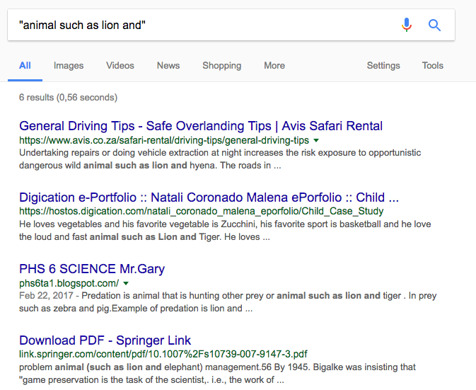
Example
Existing Term: lion
New Terms: hyena, tiger, elephant
Notes:
This is an example of how terms related to an initial term “lion” would be found using double-anchored patterns.

Slide 70
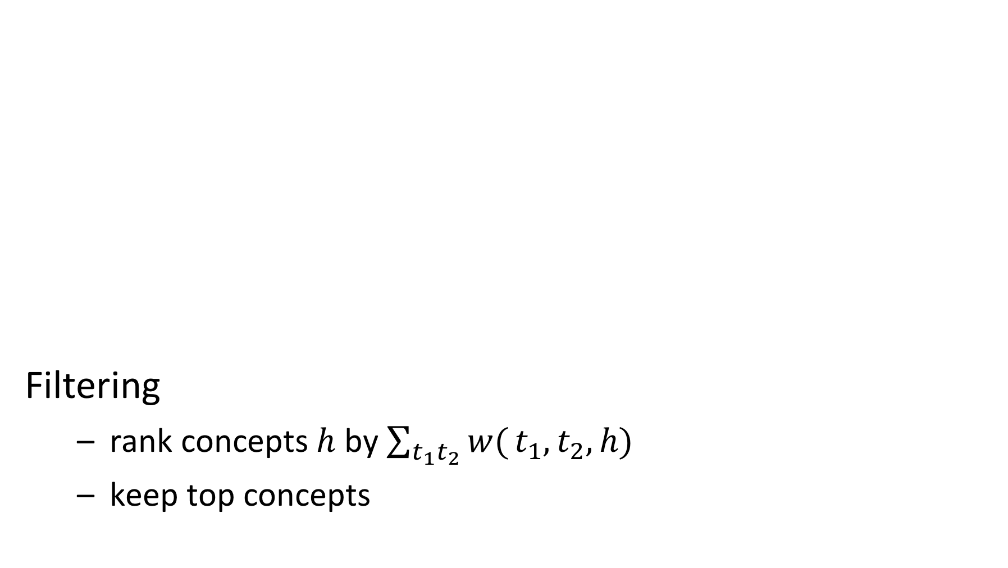
Finding Hypernyms
C = {c}
for all t₁, t₂ in T with w(t_{i}) > 0: submit P_{c}(t₁, t₂, X) to search engine
add new term h found in position X to C
add t₁ ISA h and t₂ ISA h to the hypernym relations H
w(t₁,t₂,h)++
Filtering
rank concepts $h$ by $\sum_{t_{1}t_{2}}{w(}t_{1},t_{2},h)$
keep top concepts
Notes:
Once the search for terms is completed, hypernyms can be searched by using the same patterns, but now be putting a variable X in the place of the concept, and using the basic terms found so far. In this search only terms that have been leading to the discovery of other basic concepts are being used, which is expressed by the condition w(t) > 0.
Once the search for higher level concepts is completed, a filtering step is performed. The concepts found are ranked by the number of times they have been discovered starting from different term pairs and only the highest ranked concepts are retained.

Slide 71
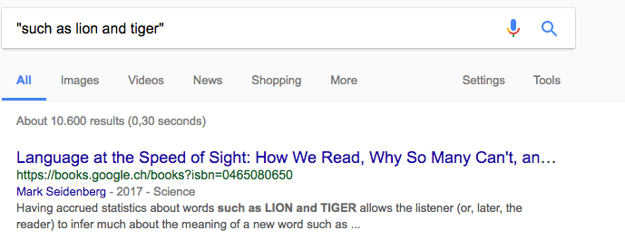
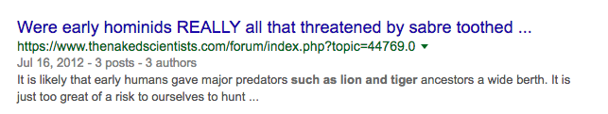
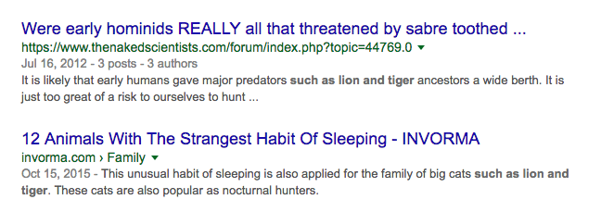
Example
New Classes: predators, big cats,
But also: words, …
Notes:
Here a few examples of how higher level concepts related to the basic concepts “lion” and “tiger” can be found.

Slide 72
Example Result
Discovery of concepts C
Discovery of terms T
Notes:
As a result of the two previous step we obtain basic data on terms for basic concepts T and higher level concepts C, together with hypernym relationships indicated by dotted arrows.

Slide 73
Inducing Hypernym Graph
Many possible relationships among concepts have likely not been discovered
Result: A directed hypernym graph H
For each pair t₁, t₂ in C
Construct query q₁ = h(t₁, t₂) and q₂ = h(t₂, t₁) with Hearst pattern h(X, Y), e.g., h(X, Y) = “X such as Y”
Submit query to search engine and count number of results
If #results(q₁) < #results(q₂) then add t₁ ISA t₂ to H else add t₂ ISA t₁ to H
Notes:
In the steps performed so far, many possible relationships among higher level concepts and basic concepts and higher level concepts may not have been discovered. For discovering those again queries against a search engine are performed, testing the two possible directions of a hypernym relationship for each pair of terms. The alternative that produces more results in the search is considered as being the correct one. As templates we can use any of the Hearst patterns, such as “X such as Y”, “X are Y that”, “X including Y”, “X like Y”, “such X as Y” etc

Slide 74
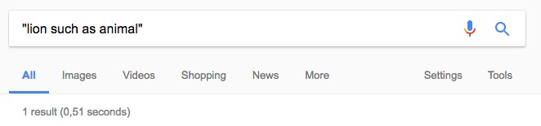
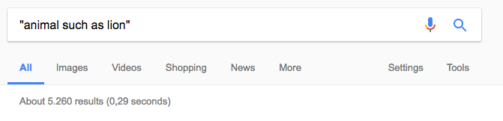
Example
Notes:
This example shows how powerful this method to test a direction of a relationship is.

Slide 75
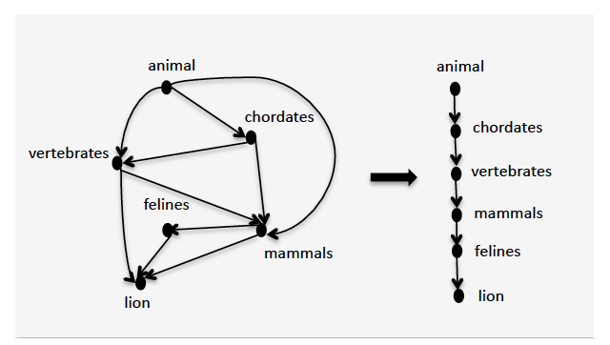
Example
Shortcuts
Graph H: may contain redundant paths
Notes:
After adding all possible relationships to the set of concepts, we obtain a graph that contains many redundant paths, including many of the induced transitive relationships. The method would, for example, find that animal ISA chordate, and chordate is a vertebrate, but also that animal is a vertebrate. In the last step such redundant relationships are removed.

Slide 76
Cleaning the Hypernym Graph
Determine all basic concepts
Not hypernym of another concept
Determine all root concepts
Have no hypernyms
For each basic concepts - root concept pair:
Select all hypernym paths that connect them
Choose the longest hypernym paths for the final taxonomy
Notes:
For cleaning up the taxonomy graph, first the basic and root concepts are identified, which are the ones that are not hypernym of another concept, resp. have no hypernym. Then for every possible pair of a root concept and a basic concept all paths between the two are extracted, and only the longest one (or the longest ones) is retained.

Slide 77
If t has no Hypernym ..
It is a root concept
It cannot match c such as t and X
It is identical to the initial root concept
It is a basic concept

Slide 78
References
Lecture partially based on
Dan Jurafsky and James H. Martin, Speech and Language Processing (3rd ed. Draft), Chapter 21 https://web.stanford.edu/~jurafsky/slp3/
Jay Pujara and Sameer Singh, Mining Knowledge Graphs from Text, Tutorial, https://kgtutorial.github.io
References
Mintz, Mike, et al. "Distant supervision for relation extraction without labeled data." ACL 2009.
Riedel, S., Yao, L., McCallum, A., & Marlin, B. M. Relation extraction with matrix factorization and universal schemas. ACL 2013.

